Slide 1
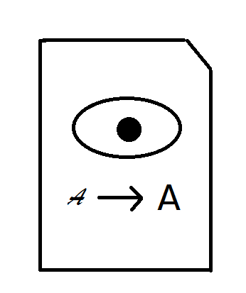
Easy See Notes Final Phase
Allows text to be shared from teachers to students and shown in a way that best suits their needs
Jacqueline Madden

Slide 2



The Process
Uses pdf-lib and AWS Textract to extract text from pdfs and display them on the webpage
Uses S3 to save and load the text
Is hosted on an EC2 instance

Slide 3


The Webpage
Has 18-point font in black and white or white on black when in dark mode and can be resized to 200% with out loss of content or functionality as recommended by the Web Content Accessibility guidelines
Uses Atkinson Hyperlegible font designed by The Braille Institute that is recommended for people with vision loss

Slide 4
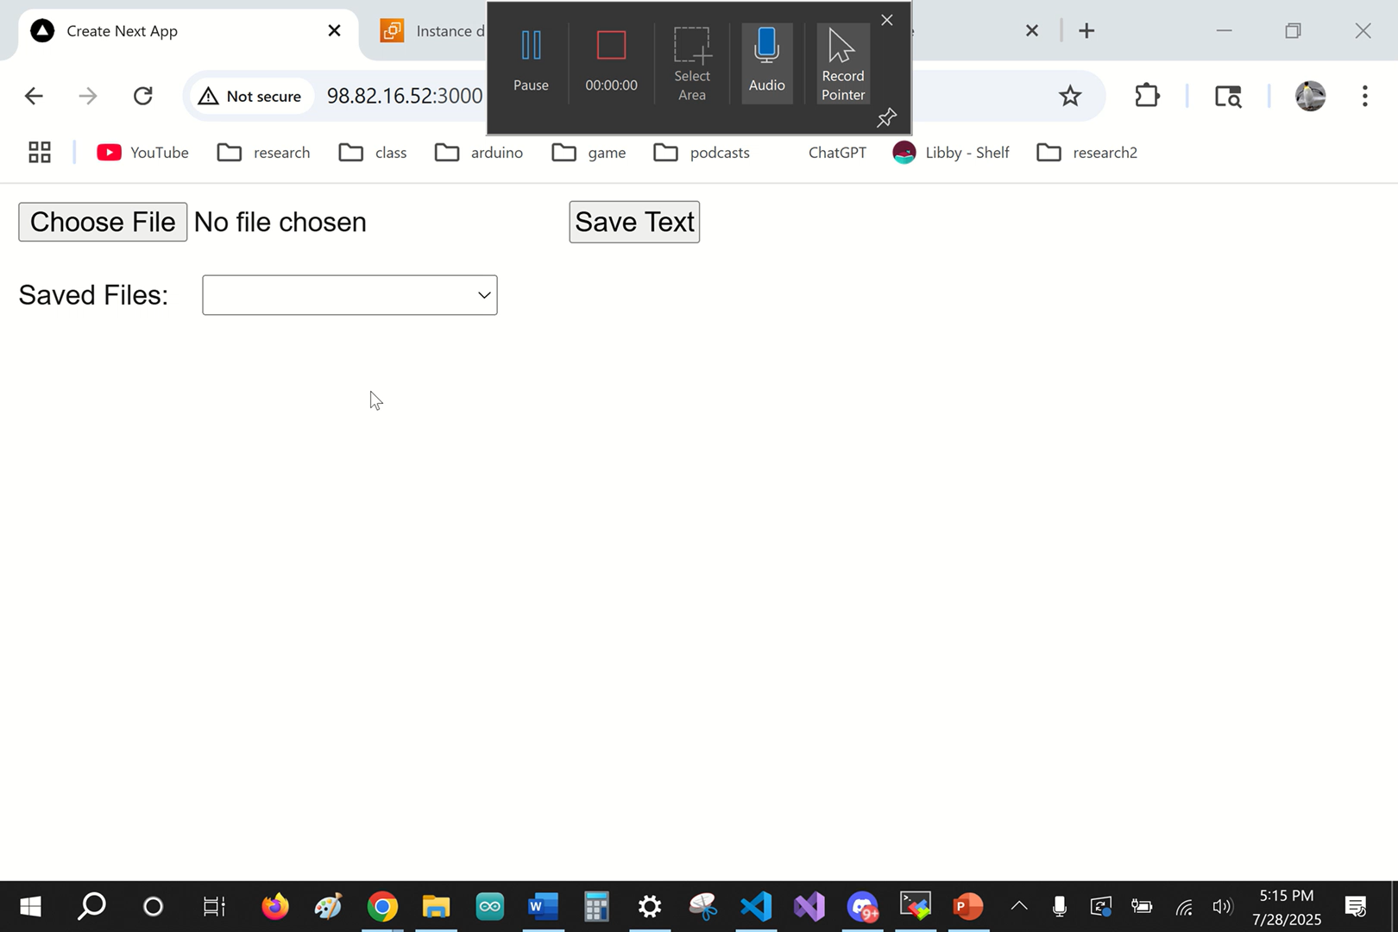
Demonstration

